Slide 1
Idle Walker
C.APP
Andrew Buikema, Cameron Fullerton, Phillip Buckreis, Peter Hansen

Slide 2
Members
Cameron Fullerton, Team Leader
Andrew Buikema, Lead Developer
Phillip Buckreis, Game Designer
Peter Hansen, Graphics/Sound Design

Slide 3
Road Map
Project Description
Directory Structure
Schedule
Risk Management

Slide 4
Project Description
Idle Game
Game that doesn't require playing to progress
Path ways
Earn rewards for completing paths
Auto walkers
Buy upgrades that help you earn more points
Progression
Each path becomes longer and more difficult
Enemies
Unique enemies to battle

Slide 5
Project Description (cont.)
Android Studio
Java, XML
Target Group
Smart phones
Motivation
Get to have fun while being active

Slide 6
Directory Structure
SourceCode
Assets
Documentation
Meeting Minutes
Reports
IdleSRC
Google Drive

Slide 7
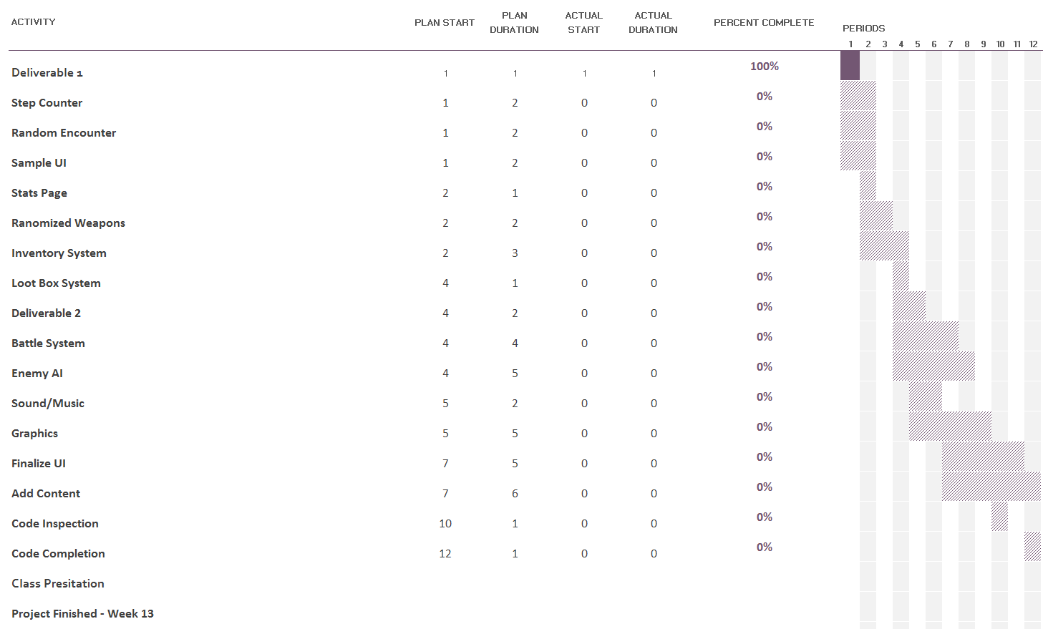
Schedule
9/13 - Deliverable 1
9/14 - Project proposal Presentation
9/23 - Step Counter, Random Encounter, Sample UI, Stats Page
9/30 - Randomized Weapons
10/7 - Inventory System
10/10 - Deliverable 2
10/14 - Loot Box System
10/28 - Battle System, Music/Sound
11/04 - Enemy AI
11/13 - Code inspection
11/18 - Graphics
11/27 - Code completion
11/27 - Final report
11/28 - Class demo and presentation
12/2 - Finalize UI, Added Content
12/5 - in class usability testing

Slide 8
Risks
Knowledge
Evaluation
Access to software/hardware
How to combat
Project difficulty
Check deadlines to ensure reasonableness level of difficulty
Scheduling conflicts
Schedule meetings in advance
Team members weakness/lack of involvement
Keep open line of communication

Slide 9

Questions?

